Slide 1
Workshop 2 – GNI Geopolitics & Global Competition
November 15, 2018
Ken Luongo

Slide 2
New Global Security Paradigm
The international security landscape has shifted focus from fighting terrorism to addressing the great power rivalry and competition between the U.S., China and Russia.
These global powers are strategically competing to increase their global political, economic, military, and diplomatic influence.
New U.S. National Security Strategy and National Defense Strategy:
Upgrade political, economic and diplomatic instruments.
Promote research, technology, and innovation.
Embrace energy dominance.
Photo Credit: Edmon de Haro
Notes:
National Security Strategy of the USA, December 2017, https://www.whitehouse.gov/wp-content/uploads/2017/12/NSS-Final-12-18-2017-0905-2.pdf
2018 National Defense Strategy of the US, January 2018, https://www.defense.gov/Portals/1/Documents/pubs/2018-National-Defense-Strategy-Summary.pdf

Slide 3
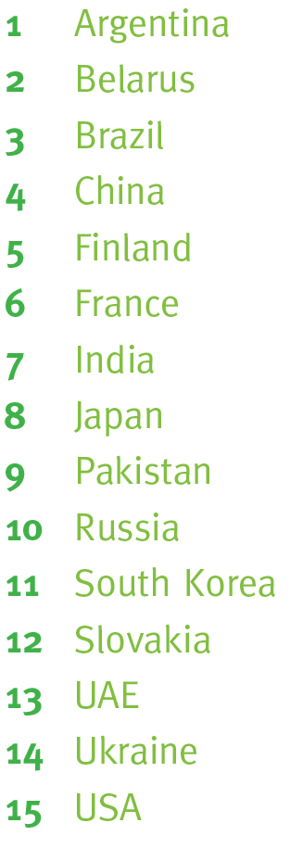
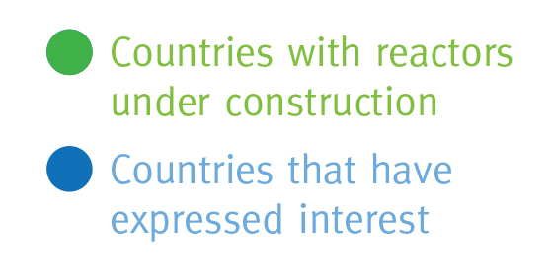
Nuclear Power: Instrument of Geopolitical Influence
Countries With Reactors Under Construction VS Those Who Have Expressed Interest
Nuclear power has a significant national and international security value, not limited to energy or cost analyses.
Deep cooperative relationships between nuclear suppliers and recipient nations are developed in the course of building and operating a nuclear plant and through the transfer of technology, which can last for about 100 years.

Slide 4
Supplying the Next Wave of Nuclear Power
Traditional nuclear suppliers, including the U.S. and its allies, have primarily written the current safety and non-proliferation rules. They are in the process of losing ground on nuclear commerce to Russia and soon China.
These aggressive nuclear commercial ambitions are state-backed and integrated into countries strategic and geopolitical objectives.
Non-Legacy Nuclear Suppliers
Traditional Nuclear Suppliers
Nuclear Hegemony
Notes:
(Big Geopolitical Question that needs to be discussed) Who is going to supply the next wave of nuclear power – LWRs and advanced reactors - and how committed are they to ensuring the highest levels of governance – safety, security and nonproliferation?

Slide 5
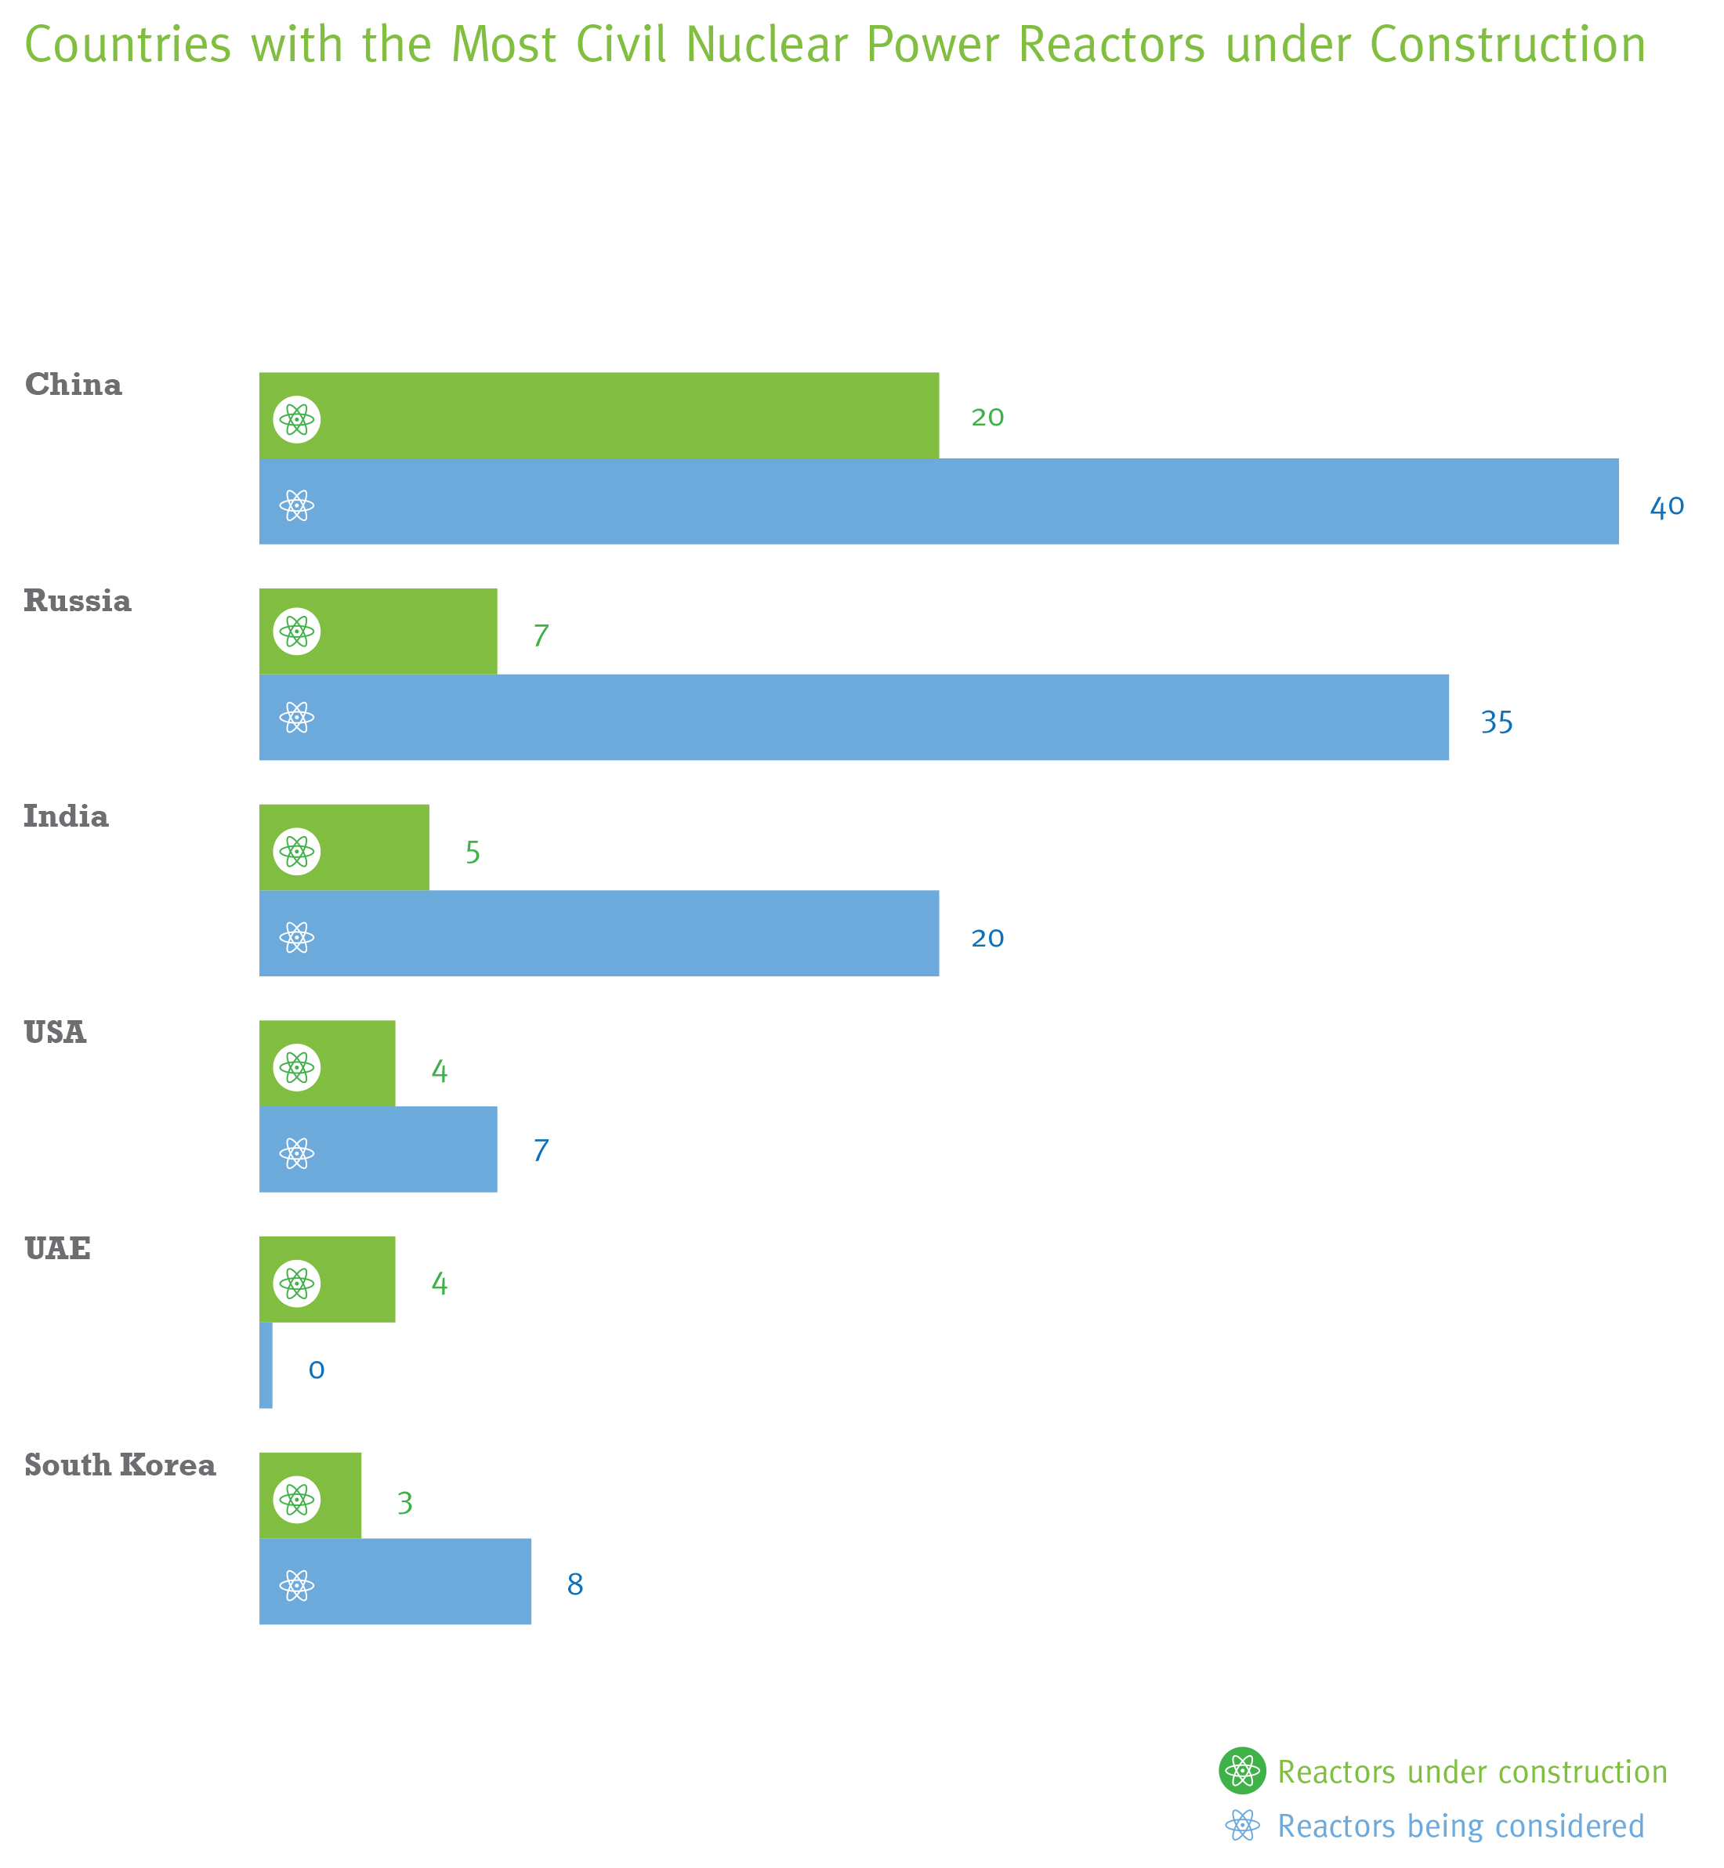
Evolving Nuclear Suppliers
Traditional nuclear suppliers, the U.S. and its allies, are now losing ground on the nuclear commerce market, focusing more on preserving existing plants and preparing for decommissioning, while Russia and China are moving ahead, trying to dominate the market.
Countries with the Most Civil Nuclear Power Reactors under Construction
China and Russia are increasing their nuclear energy exports by offering new arrangements with the goal of increasing their international influence.
By 2026, China is projected to overtake the U.S. as the world’s top nuclear power generator – making it the largest operator and market in the world, raising major concerns about the future international relations, electric power dependency, nuclear governance and global economics.
Notes:
Russia and China have authoritarian governments, serious corruption problems, and a poor record of being responsible global leaders that could undermine the influence of the nations that historically have been most active in building and improving the global nuclear governance system.

Slide 6
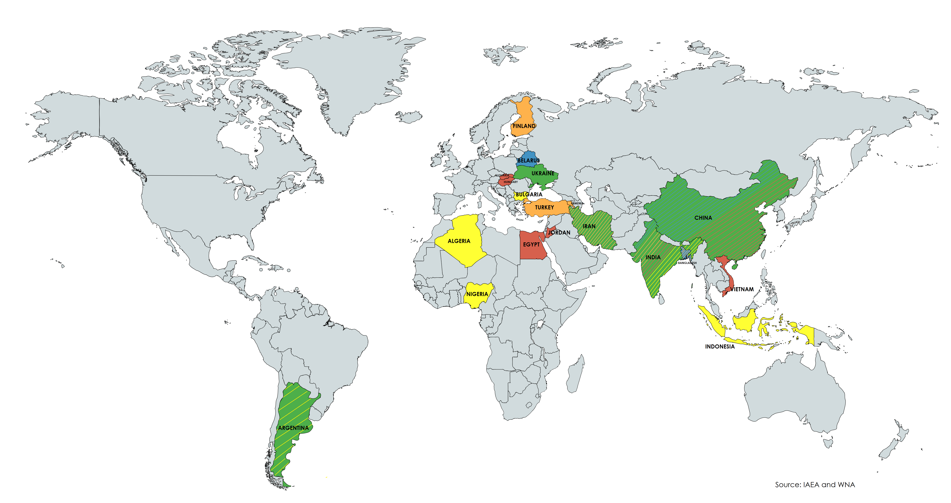
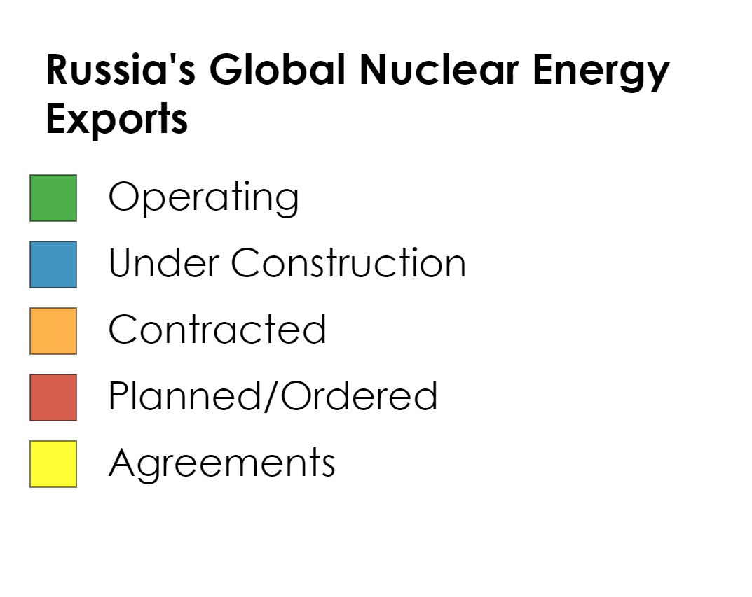
Russia
Where Russia is Expanding It’s Nuclear Geopolitical Interests
Aggressively marketing its nuclear technology abroad
Attractive package offers: Build-Own-Operate-Transfer – to newcomer customers.
Rosatom has established a global presence in 44 countries, building nuclear plants in ½ dozen.
Notes:
Russia operates 8 nuclear plants, has 5 currently under construction, 10 contracts, 17 planned/ordered, and up to 24 nuclear energy proposals/agreements.

Slide 7
Russian Gen. IV Developments
Developments of Fast Neutron Spectrum Reactors:
SVBR-100
Brest-OD-300
BN Beloyarsk
Lead-bismuth-cooled SMR
Pilot unit expected to be built at the Research Institute of Atomic Reactors; Future progress unlikely due to low internal and external demand.
Lead-cooled SMR, reactor lifetime of 30 years
Plans to start development of fuel fabrication plant in Tomsk, Siberia. (Jan. 2018)
BN-600: operational since 1980, reactor functioned as a breeder reactor until 2012, since then, as a burner reactor using weapon-grade plutonium.
BN-800: MOX fuel, connected to grid in 2016. Export agreement discussed with China in 2009 and 2016. Current status of deal is unknown (Issues with funding, tech transfer and intellectual property)
BN-1200: two reactors to be built at the Beloyarsk and South Urals plants by 2030. Construction put on “indefinite hold”, no decision to continue will be made before 2019.
Floating NPPs :
Optimized Floating Power Unit
Equipped with two RITM-200M SMRs (70 MW). These are modified Russian naval propulsion PWRs (KLT-40C). Fuel loading completed Oct. 2018.

Slide 8
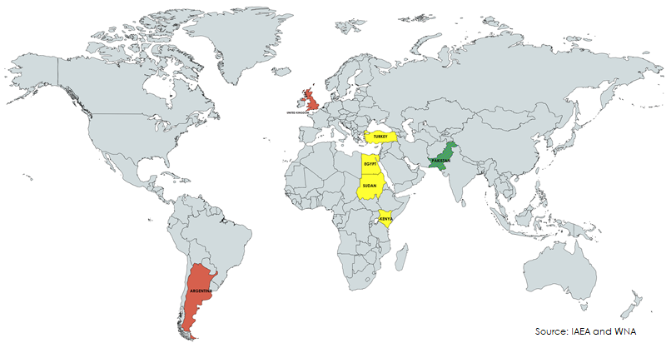
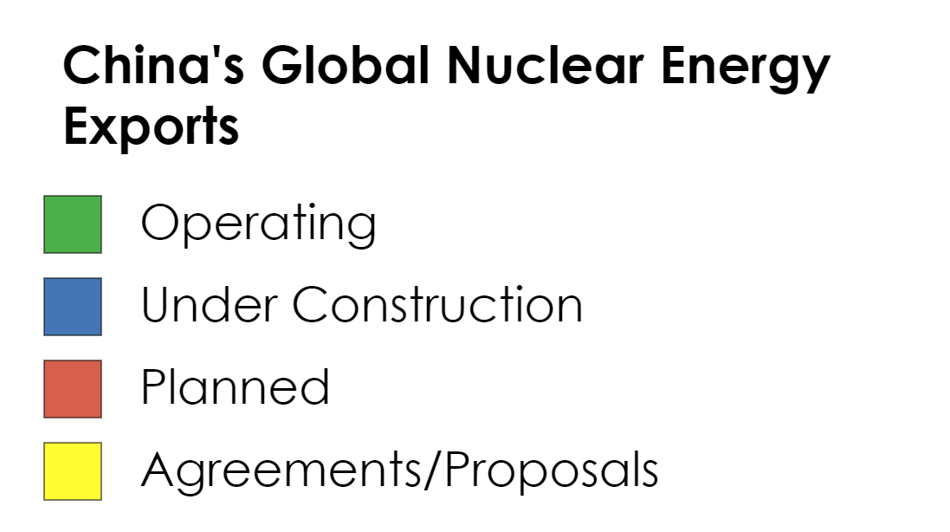
China
“Made in China 2025” aims to dominate advanced tech – robotics, AI, aviation, new energy - eroding the advantage now held by Western industrialized economies.
China’s Nuclear Energy Investments –
Will be the largest nuclear fleet operator by mid-century.
$250 M in Pakistan in 2011 and $6.5 B in 2014.
$3.2 B primarily in the U.K. in 2015.
South America and Africa planned.
“One Belt, One Road” designed as a geopolitical initiative to dominate Eurasia’s economic and trade areas and compete against the U.S. and allies - more than 65 countries have joined the initiative.
Where China is Expanding It’s Nuclear Geopolitical Interests
Notes:
World Energy Outlook, Nov 14, 2017, https://www.iea.org/weo2017/
BP Energy Outlook, 2017, https://www.bp.com/content/dam/bp/pdf/energy-economics/energy-outlook-2017/bp-energy-outlook-2017.pdf
How “Made in China 2025” Frames Trump’s Trade Threats: QuickTake, May 3, 2018, https://www.washingtonpost.com/business/how-made-in-china-2025-frames-trumps-trade-threats-quicktake/2018/05/03/6f15c41c-4e94-11e8-85c1-9326c4511033_story.html?utm_term=.df6de805da7e
China’s Technology Ambitions Could Upset the Global Trade Order, November 7, 2017, https://www.nytimes.com/2017/11/07/business/made-in-china-technology-trade.html
“Made in China 2025” is a blueprint from Germany’s “Industry 4.0”

Slide 9
Chinese Gen. IV Developments
Molten Salt Reactors
Fast Neutron Spectrum Reactors
High Temperature Gas Reactors
Annual $3 Billion budget for Thorium molten salt reactors.
CFR-600: MOX fueled, sodium-cooled pool-type fast reactor, scheduled to finish construction by 2023.
HTR-PM: TRISO-fueled pebble bed reactor, experimental plant completed in October 2017. Tests completed in April 2018.
Cooperative Research and Development Agreement with ORNL: development of fluoride salt-cooled high-temperature reactors.
Plans to build a 1000-1200 MWe unit using uranium alloy metal fuel. Unit construction estimated to begin in 2028.
Memorandum of understanding signed in 2017 between China and Saudi Arabia for the HTR-PM reactor desalination joint-venture.

Slide 10
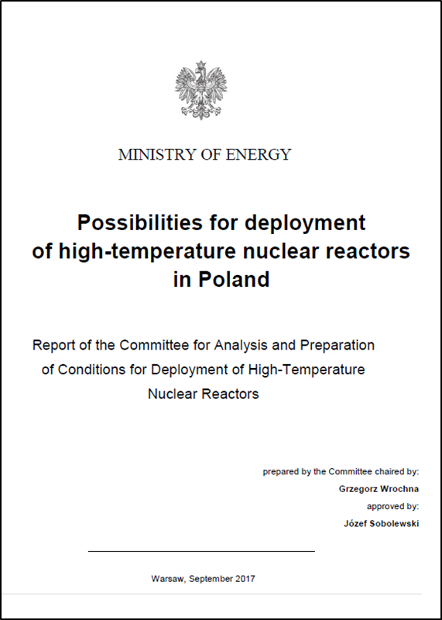
Example of the Challenge – Poland
Polish Ministry of Energy released a Report in 2017 demonstrating domestic energy and economic advantages of pebble bed reactor deployment.
“The most advanced country in the implementation of HTGR technology is China”

Slide 11
Avoiding a Race to the Bottom
As the nuclear landscape evolves, it is critical to prevent international governance norms and standards from being eroded by countries in pursuit of sales and market share.
Governments, international institutions, the nuclear industry, and civil society need to work together and form strong partnerships to continue supporting innovative, effective, credible, and rapid governance responses to new, evolving, technological and geopolitical challenges.
Notes:
Photo credit: Lukas Budimaier

Slide 12
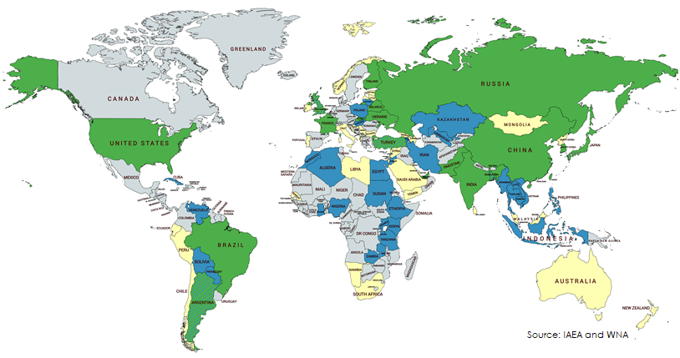
Inexperienced Nuclear Newcomers A Growing Challenge
Civil nuclear expansion is focused in tense and stability challenged regions - NE Asia, Middle East and Africa, which are and will continue to experience large energy demand increases.
Educational, regulatory, and training systems are in need of significant strengthening.
The Collective necessity is to ensure that nuclear newcomers are prepared to safely and securely operate their nuclear infrastructure.
Countries Pursuing Nuclear Reactor Technology
Notes:
Findings of the Investigation into China’s Acts, Policies, and Practices Related to Technology Transfer, Intellectual Property, and Innovation Under Section 301 of the Trade Act of 1974, March 22, 2018, https://ustr.gov/sites/default/files/Section%20301%20FINAL.PDF
3PLA - China’s People’s Liberation Army, Third Department - China’s equivalent to the U.S. National Security Administration — is crucial to the country’s military strategy, responsible for monitoring much of the world’s communications for threats and commercial opportunities.
Example: The Office of the U.S. Trade Representative recently reported that China’s intelligence agency, 3PLA, infiltrated Westinghouse servers and stole trade secrets in 2010 and 2011.

Slide 13
Strong Nuclear Governance Must be Maintained
Strong nuclear governance must be maintained if nuclear power is to continue being a major provider of zero carbon energy.
Nuclear challenges are constantly evolving and the governance system is increasingly under novel pressure from new suppliers, newcomer nations, and non-state actors.
Strengthening public confidence through enhanced safety and security measures is essential.
Governments, international institutions, the nuclear industry, and civil society need to work together to create effective, credible, and rapid governance responses to new realities.

Slide 14
IDEA: Forging a New Nuclear Alliance?
Nuclear Consortium Model
U.S.
Japan
Canada
South Korea
France
U.K.
Should the U.S. and its allies collaborate rather than compete in the global nuclear market to counter geopolitical challenges and competition?
A consortium will require leveraging each nations’ comparative advantages and capabilities and offer an integrated alternative to Russia and China.
Possible Division of Labor - some nations are better at the hardware of nuclear power – hot production and supply lines; others are better at the software – design, governance, operations, regulations, and education.
Collective financing and incentives?

