Slide 1
GNI Advanced Reactors Safeguards Analysis & Findings
November 15, 2018
Anita Nilsson, Caroline Jorant, Ashley Finan, Everett Redmond, Ken Luongo

Slide 2
Why Advanced Reactors?
Potential ability to meet energy demands in underserved areas
Provide carbon-free energy
Address fuel cycle and proliferation concerns
Offer inherent passive safety features
Provide lower cost production and operational flexibility

Slide 3
Advanced Reactor Categories
Molten Salt Fuel
1
TRISO-Based Fuel
2
Fast Neutron Spectrum Reactors
3

Slide 4
Methodology for Assessing Advanced Reactor Safeguards
Compare elements of “LWR safeguards” with the relevant characteristics of each type of advanced reactor.
Assess whether safeguarding the advanced technology is likely to require the same, somewhat more, or significantly more safeguards effort compared with the application of IAEA safeguards at LWRs.

Slide 5
IAEA Safeguards at LWRs
Item Facility
1
Low Enriched Uranium Fuel
2
Source Data that Follows the Fuel Items
3
Refueling During Outage
4
All Nuclear Material is Verifiable
5

Slide 6
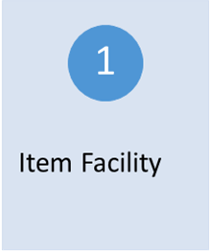
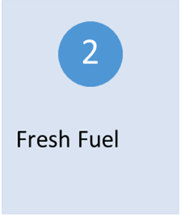
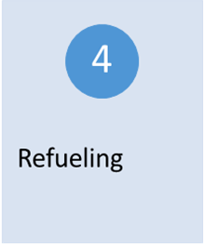
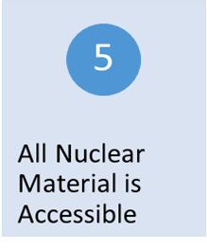
Fuel rods, in assemblies, are all identified.
Item Facility
LWR
LEU, and sometimes MOX fuel.
Fresh Fuel
Source data available for all individual assemblies.
Source Data
Refueling during outage periods.
Refueling
Yes, through visual inspection, NDA and C&S methods.
All Nuclear Material is Verifiable

Slide 7
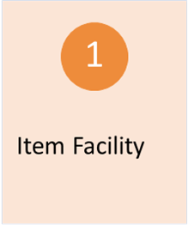
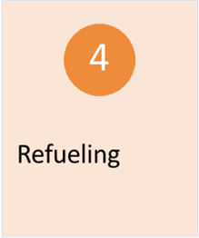
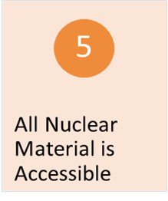
Molten Salt
Fuel is in liquid form and cannot be safeguarded as an item facility.
Reactors are likely to be subject to safeguards as a bulk material handling facility.
Item Facility
The fuel contains Uranium, with enrichment < 20% ²³⁵U.
Fresh Fuel
Incoming fuel will be well determined but cannot be matched with specific outgoing fuel. The outgoing fuel will require measurement to determine its content.
Source Data
Online
Refueling
Blue boxes indicate relative compatibility with current IAEA safeguard measures for LWR.
Orange indicates that IAEA safeguards may require considerably more efforts than a LWR.
The fuel will require NDA measurement alternatively, under certain conditions, C&S.
All Nuclear Material is Verifiable
Further study required:
Various design models will have to be further analyzed; quantities of fuel in reactor core and outside in the different size reactors, projected refueling, and the duration of its operating cycle.
Isotopic composition of the irradiated fuel: how contained uranium and mixed thorium will change with radiation.

Slide 8
TRISO-Based
With unidentifiable fuel particles (pebbles) the reactor will not meet the basic have characteristics consistent with in item-facility and does not conform to item-based or bulk-based safeguard approaches.
Item Facility
Uranium oxicarbide (enrichment <20% ²³⁵U) in graphite pebbles or hexagonal prisms.
Fresh Fuel
Source data for production batches. Data for flows of material to be measured. In present designs, there is difficulty in matching fresh fuel with discharged irradiated fuel.
Source Data
Online or during outage (Prisms). Pebbles will be identical but not possible to identify when moving into or out of the reactor during online refueling.
Refueling
Blue boxes indicate relative compatibility with current IAEA safeguard measures for LWR.
Orange indicates that IAEA safeguards may require considerably more efforts than a LWR.
As a stream of identical particles. The material flow requires further analysis
All Nuclear Material is Verifiable
Further study required:
Fuel for specific reactor designs: variation of nuclear material in individual pebbles post-irradiation, the feed and measurement of pebbles during online refueling, and the various sizes of reactor cores.
How to identify individual fuel units?

Slide 9
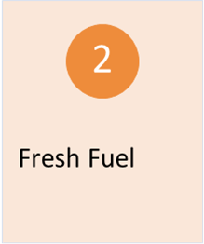
Fast Neutron Spectrum
Fuel Assemblies are similar as in a LWR
Item Facility
LEU is less than 20% ²³⁵U
Potential presence of separated plutonium in unirradiated fuel is a higher proliferation risk than those that contain LEU.
Fresh Fuel
Source data available for each unit, as for LWR fuel.
Source Data
During outage. Some very long operating periods.
Refueling
Blue boxes indicate relative compatibility with current IAEA safeguard measures for LWR.
Orange indicates that IAEA safeguards may require considerably more efforts than a LWR.
Blue boxes indicate relative compatibility with current IAEA safeguard measures for LWR.
Orange indicates challenges with comprehensive safeguards agreements and Additional Protocols.
Yes, through visual inspection, NDA and C&S methods. Further evaluation is required.
All Nuclear Material is Verifiable
Further study required:
Individual reactor designs: clarification regarding quantities of fresh fuel normally in storage, size of reactor core and individual fuel elements in various designs.

Slide 10
None of the advanced reactor design categories can be safeguarded in the same manner as a LEU-fueled LWR.
PEBBLE BED AND MOLTEN-SALT REACTORS OFFER SIGNIFICANT NEW CHALLENGES IN VERIFYING ITEMS IN THE REACTOR AND FUEL CYCLE.
Fast reactors are closer to the LWR model but present some unique problems and have the added complication of the potential for separated plutonium.

Slide 11
Safeguards Recommendations
IAEA
Review present safeguards approaches and identify technical problems for safeguards implementation and verification. Develop new safeguards approaches and criteria for the new reactor types and identify weaknesses in the availability of effective tools for verification, e.g. C&S.
Reactor Designers
Review designs considering how to meet the established IAEA safeguards systems. Recognize that the definition of an item-facility and its impact on the general acceptance of the technology. Reduce time span between refuelling and quantity of fresh fuel stored on-site.
IAEA & Reactor Designers
Initiate an interactive process to explain safeguards system, and identify safeguards-challenging elements of the technology. Take steps in the design phase to facilitate international safeguards.

