Slide 1
Communication strategy & planning
Richard A. Mahony
Global Nexus Initiative Working Group Meeting
November 15, 2018

Slide 2
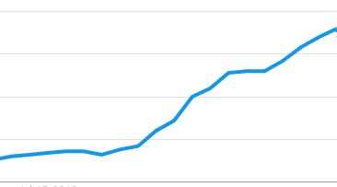
Interest in nuclear energy is rising…
Search queries for “nuclear energy”
100
75
50
25
June 2018
Nov 2018
Source: Google Trends, US

Slide 3
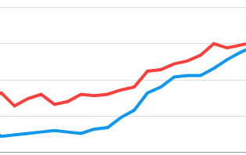
… and it narrowed the renewables gap…
+ Search queries for “renewable energy”
100
75
50
25
June 2018
Nov 2018
Source: Google Trends, US

Slide 4
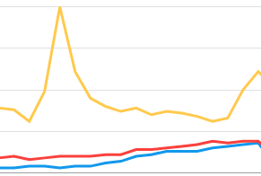
… but keep it in perspective
+ Search queries for “Kardashians”
100
75
50
25
June 2018
Nov 2018
Source: Google Trends, US

Slide 5
Strategy for communication success
Use images and graphics to make complex information understandable
Have a unifying visual language to magnify impact
Create sound-bites to enliven the message and make it memorable
Seek controversy (prudently) to sustain attention
Leverage contact networks to reach key people
Develop original data & analysis to build relationships outside your traditional sphere

Slide 6
Communication planning for GNI report
Pre-launch
Launch
Post-launch
Refine messages
Design final report
Develop infographics
Pitch advance press exclusive
Update email contact list
Secure endorsements
Issue press release
Launch social media campaign
Begin email distribution
Update websites & LinkedIn page
Hold in-person briefings (Capitol Hill, Silicon Valley, etc.)
Follow-up media interviews
Prepare guest article for publication
Arrange webinar & conference appearances
Consider producing digital ads & video

Slide 7
Questions for discussion
?
What’s the most important message in the report?

Slide 8
Questions for discussion
?
What audiences do you want to be sure to reach with your message?

Slide 9
Questions for discussion
?
Which techniques are most effective in reaching your audiences?

Slide 10
Questions for discussion
?
What is the biggest risk to avoid when communicating about the report?

